Slide 1

Agentic Agile Platform
An intelligent, multi-agent system transforming Agile delivery through AI-powered insights, automated workflows, and contextual intelligence for leadership and Scrum teams

Slide 2




Platform Architecture Overview
Our agentic platform orchestrates multiple specialised AI agents to deliver comprehensive Agile intelligence across your organisation.
Analysis Agent
Visualisation Agent
Text-to-Query Agent
Processes sprint metrics, velocity trends, and team performance data to identify patterns and anomalies
Transforms complex data into intuitive dashboards and actionable visual insights tailored to role-specific needs
Enables natural language queries against Agile data, making insights accessible to non-technical stakeholders

Slide 3
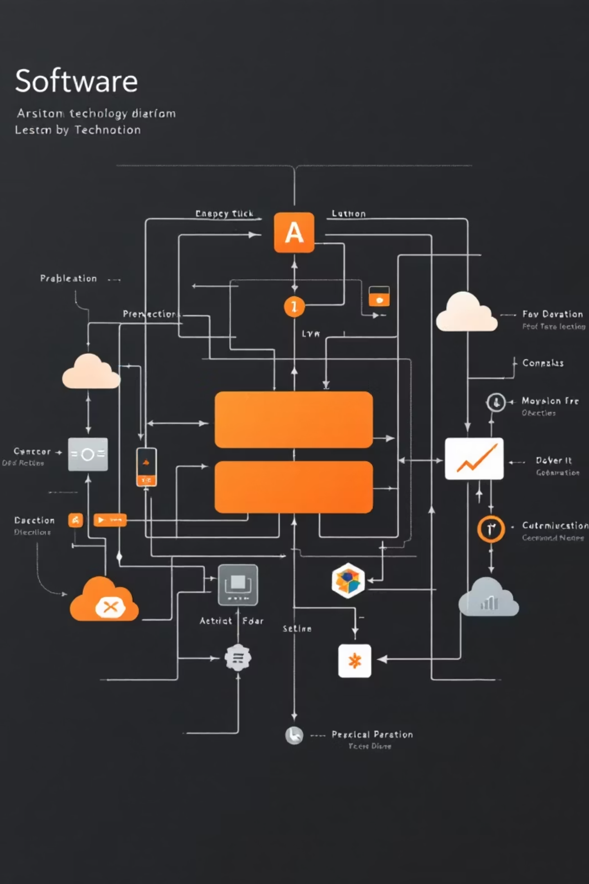
Technical Stack
Backend Infrastructure
Frontend Architecture
LangChain: Powers agent orchestration and LLM integration
React.js: Modern, component-based UI framework
LangGraph: Manages stateful multi-agent workflows
Responsive design for desktop and mobile
FastAPI: High-performance API layer for real-time data processing
Real-time updates via WebSocket connections
Role-based access control and personalised dashboards
RESTful endpoints with async processing

Slide 4




LangGraph Orchestration Framework
LangGraph coordinates our multi-agent system through stateful workflows, ensuring seamless collaboration between specialised agents.
User Request
Agent Routing
Natural language query or dashboard interaction
LangGraph directs request to appropriate agent
Agent Execution
Response Synthesis
Specialised processing with context retention
Aggregated insights delivered to user
The framework maintains conversation context, enabling multi-turn interactions and complex analytical workflows.

Slide 5

Angelo Dashboard: Leadership Intelligence
The Angelo Dashboard provides leadership with strategic oversight of Agile delivery across the organisation.
Portfolio Health
Risk Indicators
Cross-team velocity trends, predictive delivery timelines, and resource allocation insights
AI-identified blockers, dependency conflicts, and sprint commitment risks with recommended actions
Strategic Metrics
OKR tracking, business value delivery, and ROI analysis with comparative benchmarks

Slide 6
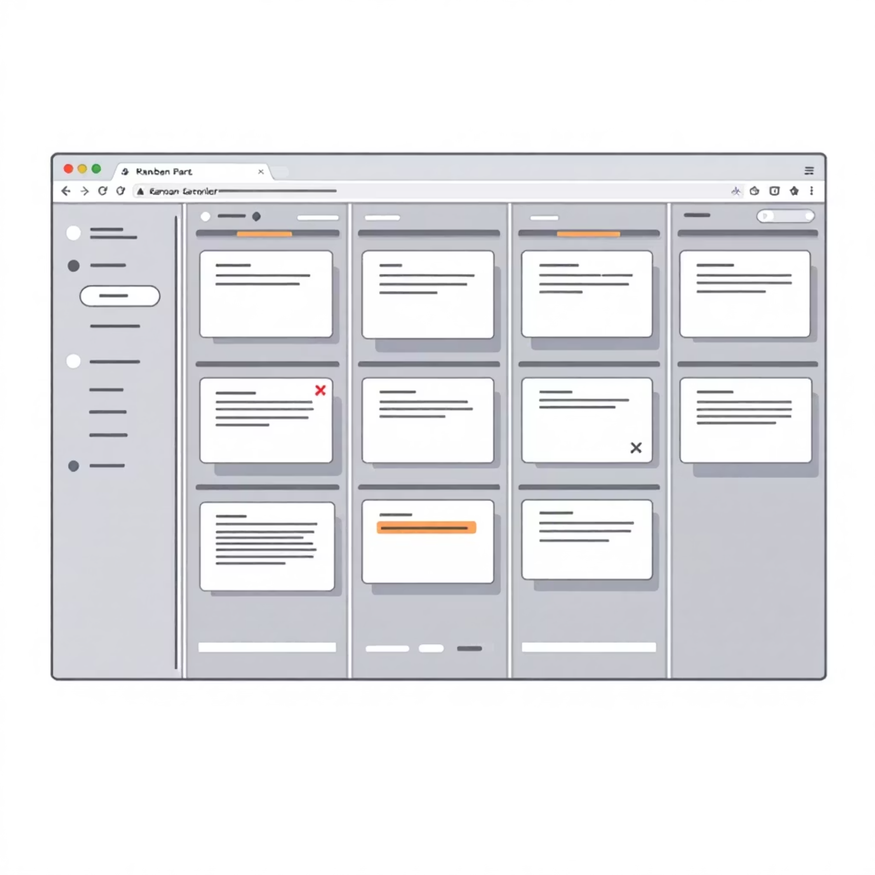
Angelo Dashboard: Scrum Master View
Scrum Masters receive detailed, actionable intelligence to optimise team performance and remove impediments.
Key Capabilities
Sprint burndown with predictive completion
Team capacity planning and workload balance
Retrospective sentiment analysis
Dependency mapping and critical path identification
Individual contributor performance patterns
Real-time alerts notify Scrum Masters of velocity drops, scope creep, or emerging blockers requiring immediate attention.

Slide 7
AI Agile Actions & Ask Susan
AI Agile Actions
Ask Susan
Proactive recommendations for sprint planning, backlog refinement, and ceremony optimisation based on historical patterns and team dynamics
Conversational AI interface enabling natural language queries about sprint metrics, team performance, and Agile best practices
Both features leverage the Text-to-Query Agent to translate requests into precise data queries, delivering instant insights without technical expertise.

Slide 8

AI-Powered Email Generation
Automated intelligence delivery ensures stakeholders receive timely, relevant insights without manual reporting overhead.
01
Analysis Completion
Analysis Agent identifies significant findings or scheduled reporting triggers
02
Content Synthesis
AI generates executive summaries with key metrics, trends, and recommended actions
03
Personalisation
Content adapts to recipient role, priorities, and previous interaction patterns
04
Delivery
Automated distribution with embedded dashboard links and actionable insights

Slide 9




System Integration & Data Flow
The platform seamlessly integrates with your existing Agile toolchain to provide unified intelligence.
Data Ingestion
Agent Processing
Jira, Azure DevOps, GitHub integration via REST APIs
Multi-agent analysis with LangGraph orchestration
Action Delivery
Visualisation
Email summaries and AI-driven recommendations
Real-time updates to Angelo Dashboard
FastAPI ensures sub-second response times for queries and real-time dashboard updates as sprint data evolves.

Slide 10

Transform Your Agile Delivery
40%
3x
85%
Reduction in Reporting Overhead
Faster Decision Making
Sprint Predictability
Real-time intelligence accelerates leadership response
AI-powered forecasting improves commitment accuracy
Automated insights eliminate manual status compilation
The Agentic Agile Platform delivers intelligent automation, contextual insights, and proactive recommendations—empowering your teams to focus on delivering value.

